Slide 1

Keys in Database Management System

Slide 2
Why we have Keys in DB?
A Key is an attribute or a set of attributes in a relation that identifies a tuple (record) in a relation.
The keys are defined in a table to access or sequence the stored data quickly and smoothly.
They are also used to create relationship between different tables.

Slide 3
Types of Keys in Database
1. Primary Key
2. Candidate Key
3. Alternate Key
4. Super Key
5. Composite Key
6. Foreign Key
7. Unique Key

Slide 4
Primary Key
Which is Unique & Can’t be have NULL Value
Is the column you choose to maintain uniqueness in a table at row level.
Here in Employee table we can choose either EmployeeID or SSN
column for a PK.
EmployeeID is preferable choice because SSN(Social Security Number) is a secure value.
Employee
EmployeeID
EmployeeName
SSN
DeptID
DOB

Slide 5
Primary Key
It is a candidate key that is chosen by the database designer to identify entities with in an entity set.
Primary key is the minimal super keys. In the ER diagram primary key is represented by underlining the primary key attribute.
Ideally a primary key is composed of only a single attribute.
But it is possible to have a primary key composed of more than one attribute.

Slide 6
To define a field as primary key, following conditions had to be met :
1. No two rows can have the same primary key value.
2. Every row must have a primary key value.
3. The primary key field cannot be null.
4. Value in a primary key column can never be modified or updated, if any foreign key refers to that primary key.

Slide 7
Candidate Key
Are individual columns in a table that qualifies for uniqueness of each row/tuple.
Here in Employee table EmployeeID & SSN are eligible for a Primary Key and thus are
Candidate keys.
Candidate Keys are super keys for which no proper subset is a super key. In other words candidate keys are minimal super keys.
Employee
EmployeeID
EmployeeName
SSN
DeptID
DOB

Slide 8
Alternate Key
Employee
EmployeeID
EmployeeName
SSN
DeptID
DOB
Candidate column other the Primary column, like if EmployeeID is set for a PK then SSN would be the Alternate key.

Slide 9
Super Key
If you add any other Column / Attribute to a Primary Key then it become a Super Key,
like EmployeeID + EmployeeName is a Super Key.
Super key stands for superset of a key.
A Super Key is a set of one or more attributes that are taken collectively and can identify all other attributes uniquely.
Employee
EmployeeID
EmployeeName
SSN
DeptID
DOB

Slide 10
Composite Key
Employee
EmployeeID
EmployeeName
SSN
DeptID
DOB
If a table do have a single column that qualifies for a Candidate key, then you have to select 2 or more columns to make a row unique.
Like if there is no EmployeeID or SSN columns, then you can make EmployeeName +
DateOfBirth (DOB) as Composite Primary Key.
But still there can be a narrow chance of duplicate rows.

Slide 11
Foreign Key
Employee
EmployeeID
EmployeeName
SSN
DeptID
DOB
Department
DeptID
DeptName
Here in above tables DeptID of Department table is Primary Key where as DeptID of Employee is a Foreign key.
It means it has referred to another table. This concept is also know as Referential Integrity.

Slide 12
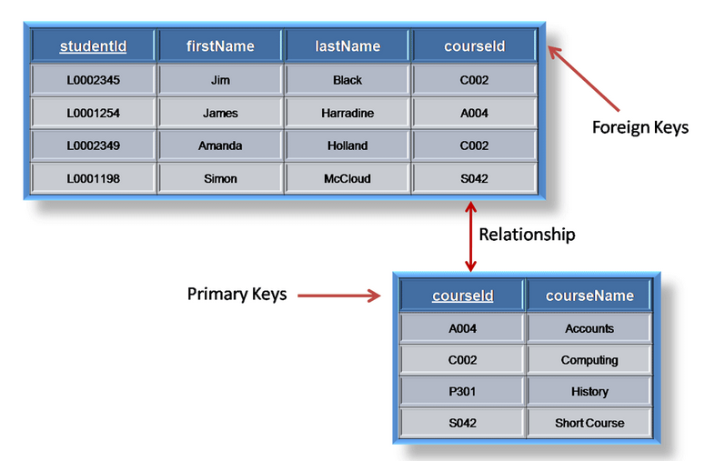

Slide 13
Unique Key
Employee
EmployeeID
EmployeeName
SSN
EmailID
DOB
Unique key is same as primary with the difference being the existence of null.
Unique key field allows one value as NULL value.

Slide 14
Practical Example
Table – R1
A
B
C
D
E
Table R1. Let A,B,C,D,E are the attributes of this relation.
A→BCDE (This means the attribute 'A' uniquely determines the other attributes B,C,D,E.)
BC→ADE (This means the attributes 'BC'
jointly determines all the other attributes A,D,E in the relation.)
Find the following:
Primary Key
Candidate Key
Super Key
Composite Key
•

Slide 15
Answers:
Primary Key: A
Candidate Key: A & BC
Super Key: A, BC, AE, AD & ABC
Composite Key: BC

